Slide 1

What Social Media Means for Future History
iDRAMA Lab
Established 2016
Jeremy Blackburn
blackburn@cs.binghamton.edu / @jhblackb
https://mrjimmyblack.com / https://idrama.science

Slide 2
WARNING
The contents of this talk covers some potentially disturbing subject matter

Slide 3
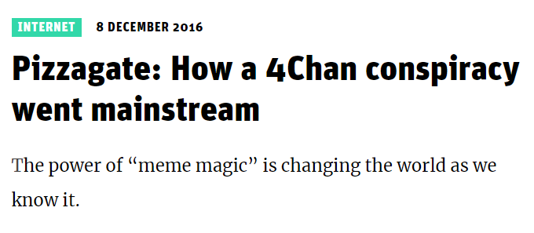
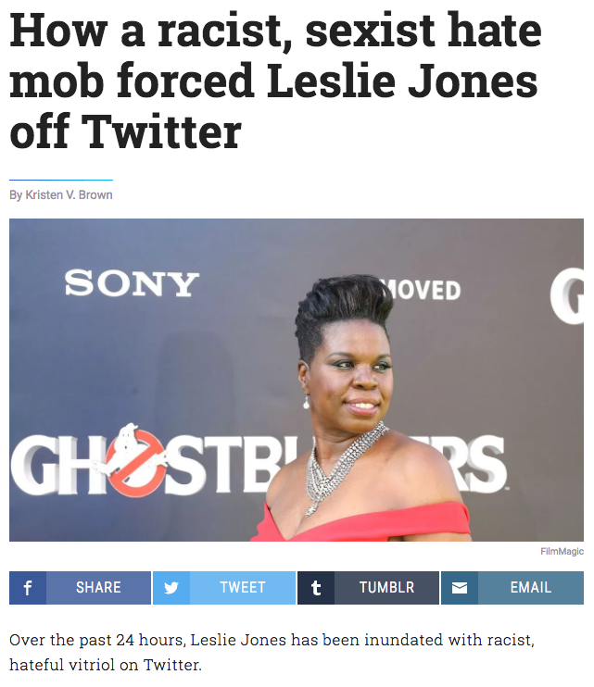
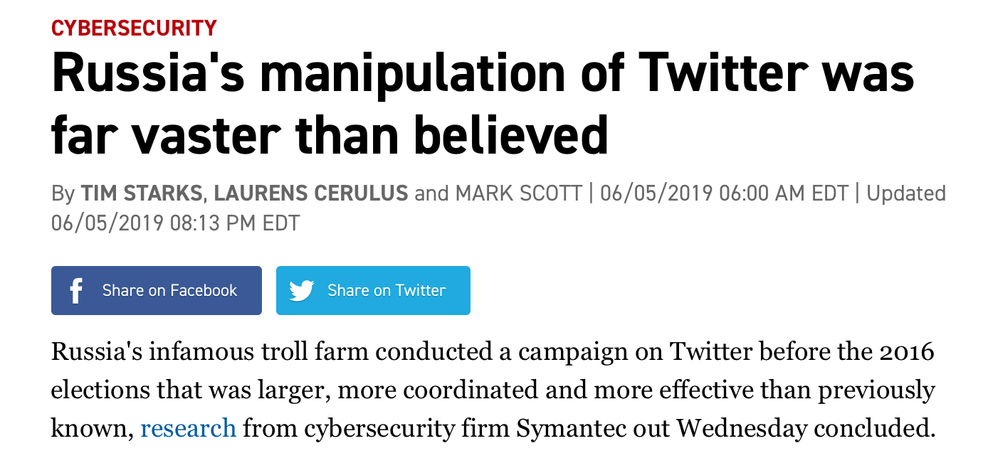
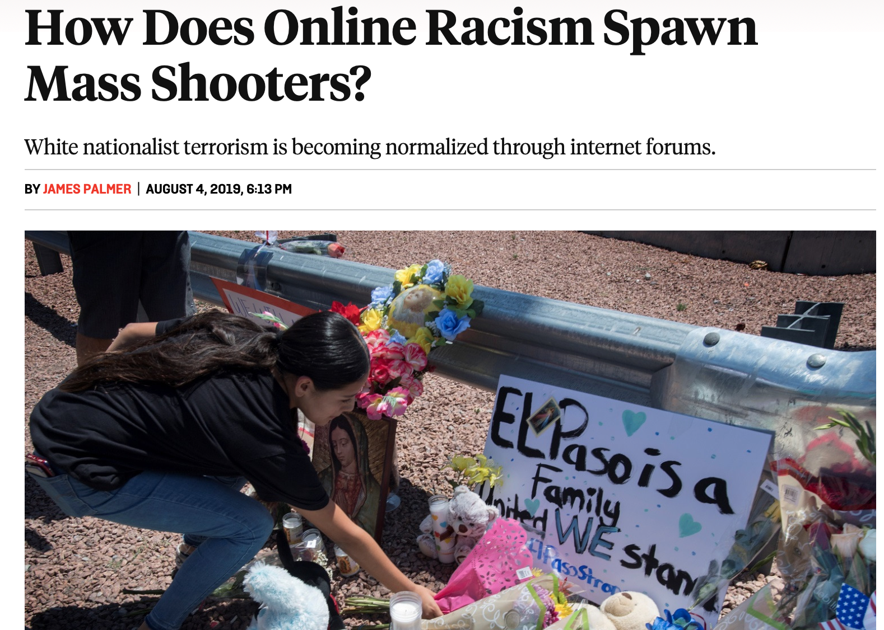

Slide 4
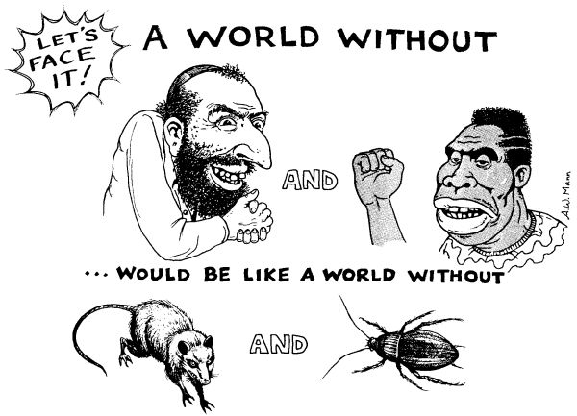


Slide 5
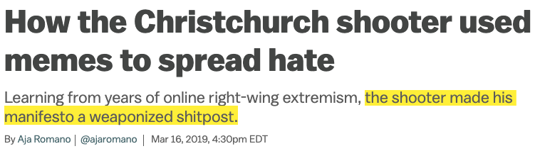
Hate/Racist Memes

Slide 6
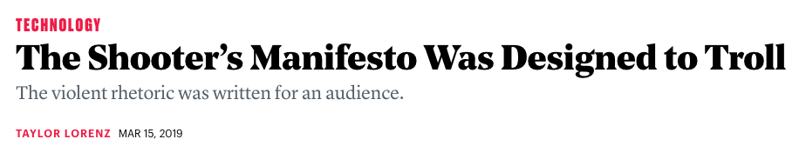
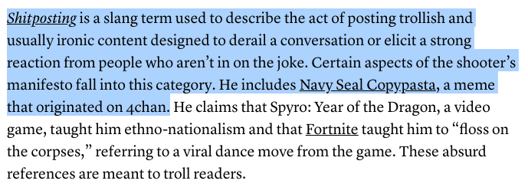
Hate/Racist Memes

Slide 7
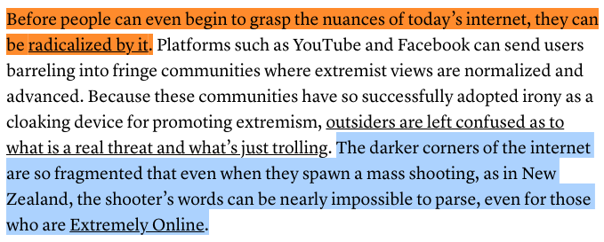
But What Do We Really Know About Memes?
How can we track meme propagation on the Web?
How can we characterize variants of the same meme?
Can we characterize Web communities through the lens of memes?

Slide 8
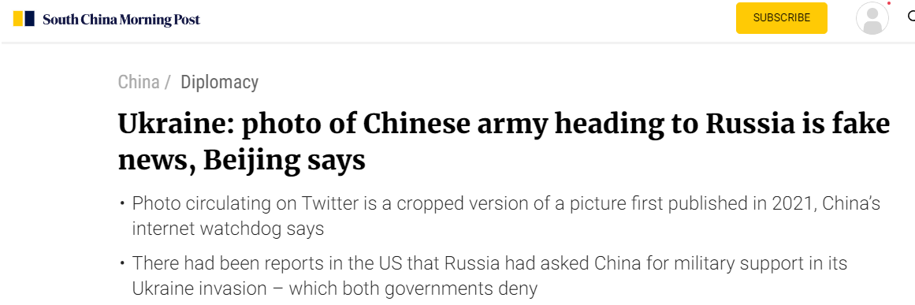

Slide 9
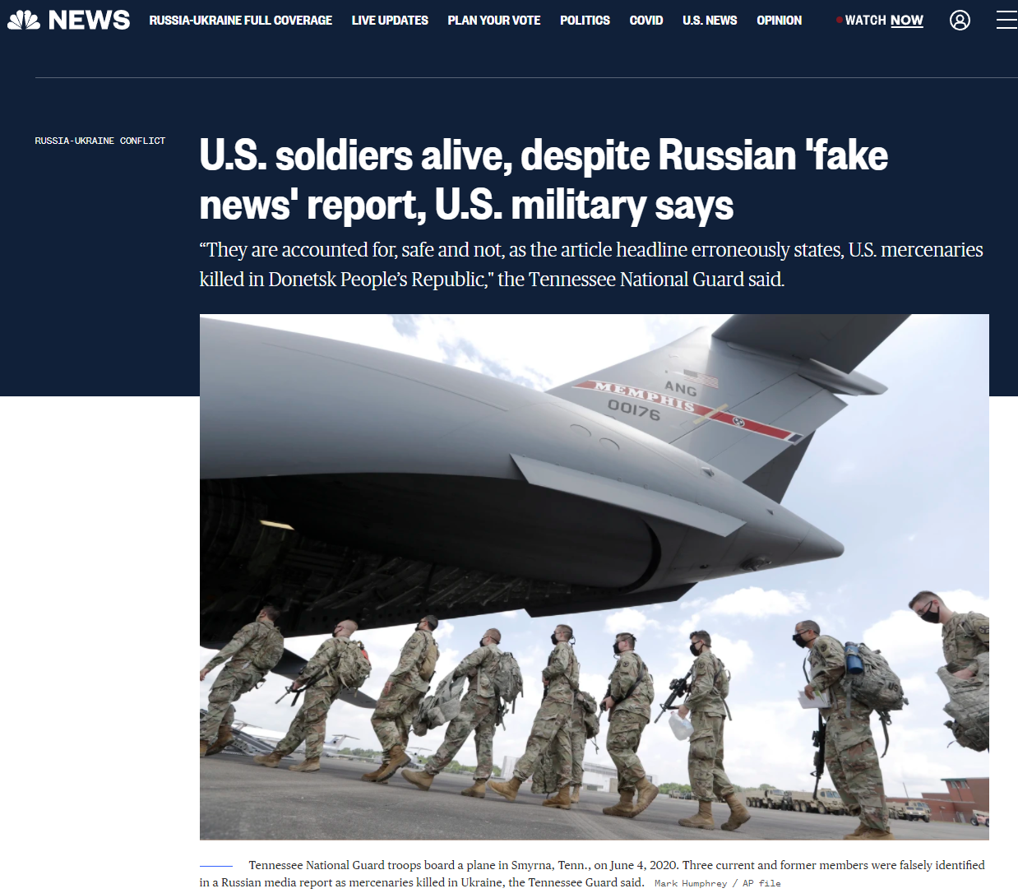

Slide 10
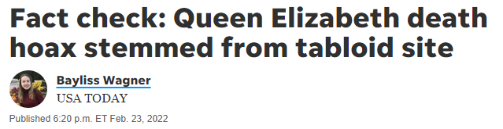

Slide 12
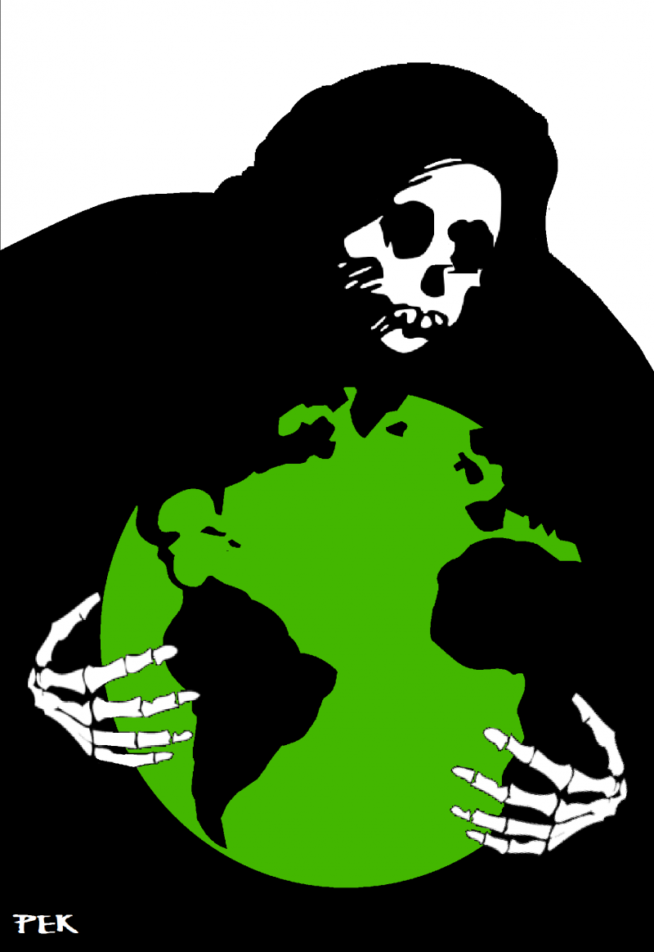
Lots of Challenges for Future Historians to Understand!
Cyberbullying
Cyberaggression
Coordinated Hate Campaigns
Radicalization
Misogyny
Mis/Disinformation
Propaganda
Intentionally Sowing Discord
Conspiracy Theories
Election Interference

Slide 13



It’s kind of hyperbole, but…

Slide 14
It’s kind of hyperbole, but…
?

Slide 15


This is a CS problem!
It is happening on our turf
We invented the modern information ecosystem
Not sociologists
Not lawyers
Not historians

Slide 16

What can we do?
We have experience mitigating unwanted activity on social media!
E.g., we can detect bot activity in social media:
It’s large-scale, synchronized, etc.
We can build classifiers based on recognizable patterns
(SynchroTrap, EvilCohort, Botometer, ...)

Slide 17

What can we really do?
What about human activity?
Human activity is less coordinated
Characteristic traits stand out less
We have loose synchronization, common talking points, etc.
We can’t fight merely on economic grounds
What works for spam, fraud, etc. doesn’t really work here
State-level adversaries have deep pockets

Slide 18
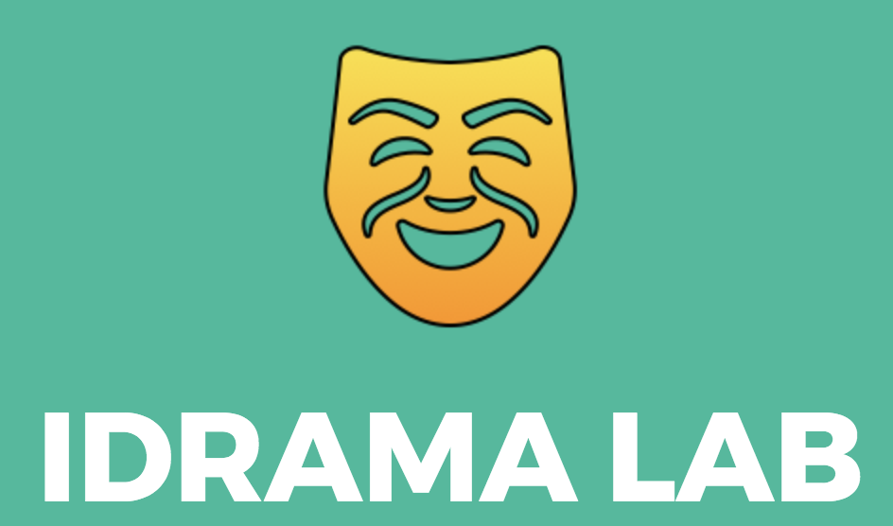
Computational methods to understand and mitigate information weaponization at large scale
Building proactive and preventive systems to counter it
Data-driven analysis of complex and intertwined communities

Slide 19
Data Collection
Crawling 4chan, Reddit, Gab, Twitter, YouTube
Processing, cleaning, storing, indexing, etc.
Data Sharing
Everything open source
Easy to use, facilitate qualitative/ social science research
Data Analysis
Statistics tools Clustering
Probability theory Contextual analysis
Longitudinal analysis Image analysis
Change point analysis Language modeling
Influence estimation Topic extraction
[Exploratory + hypotheses-driven]

Slide 20
The rest of this talk
Part 1: Jerks online
Part 2: State-sponsored actors
Part 3: Mitigation techniques

Slide 21

Online Jerks

Slide 23
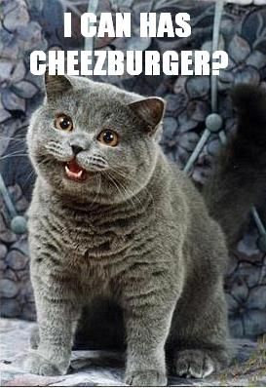

Slide 24
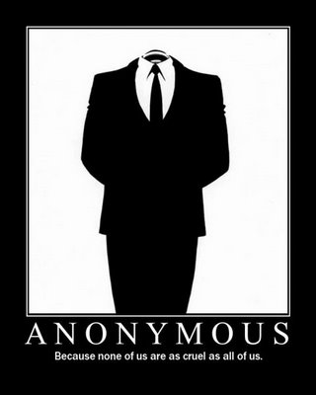

Slide 25


Slide 26
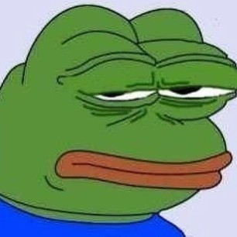

Slide 27
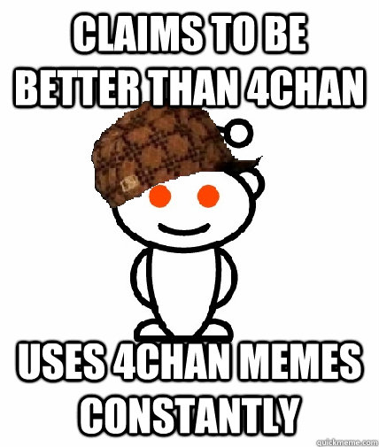

Slide 28
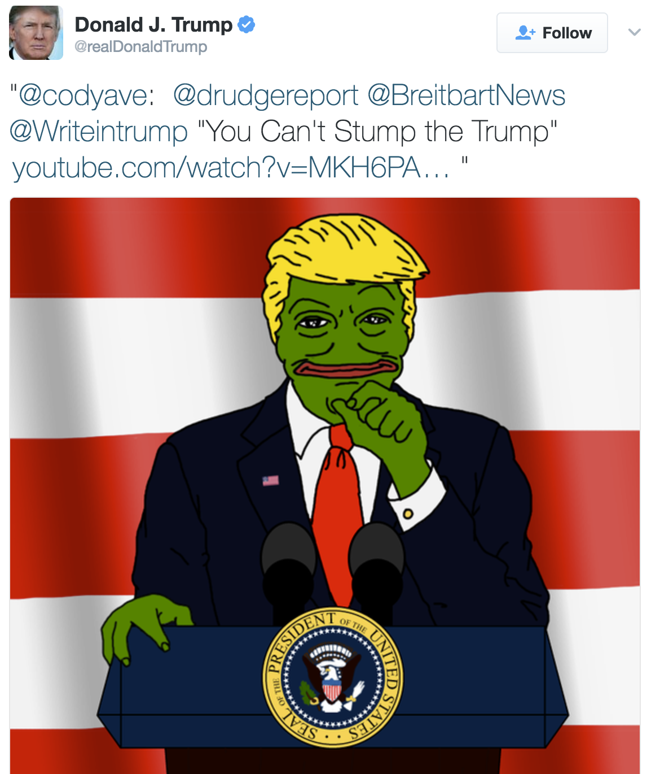

Slide 29
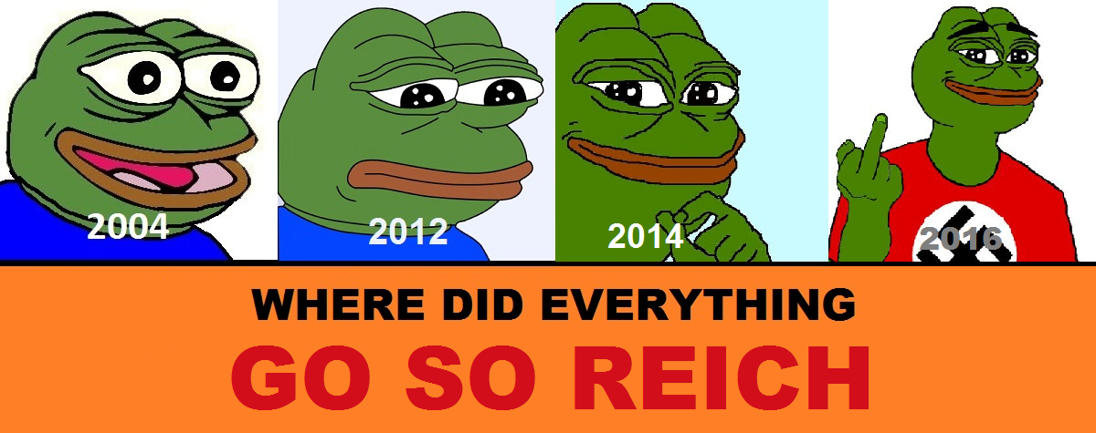

Slide 30
What Exactly Is 4chan
An image board
Conversations grouped into threads
An “original poster” (OP) creates a new thread by making a post
Single image attached
Other users can reply
With or without images

Slide 31
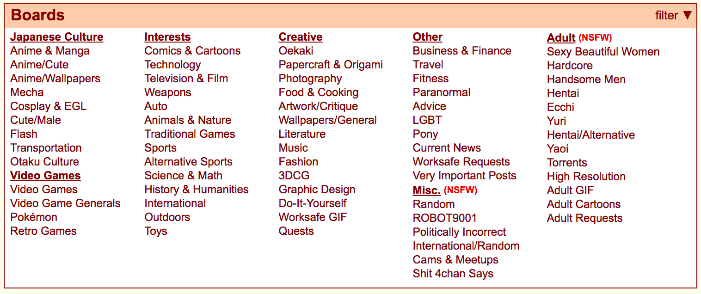
What Exactly Is 4chan
An image board
Conversations grouped into threads
An “original poster” (OP) creates a new thread by making a post
Single image attached
Other users can reply
With or without images

Slide 32
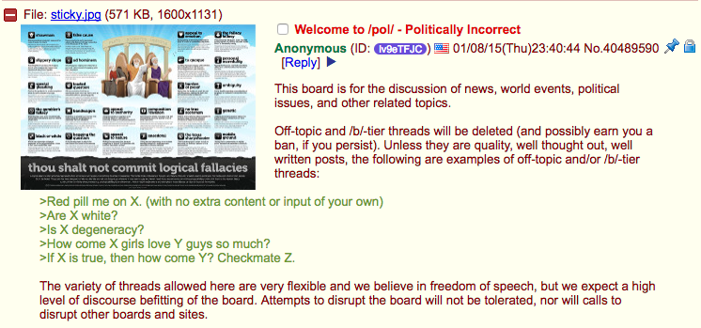
/pol/ - Politically Incorrect

Slide 33
/pol/ - Politically Incorrect
Extremely lax moderation
Almost anything goes

Slide 34
Anonymity and Ephemerality
Users don’t need to register
Anonymity is default (and preferred) behavior
There is a degree of permanence and identifiability
Can enter a user name along with a post (still no accounts)
Threads are deleted after a while
All posts deleted after about a week

Slide 35

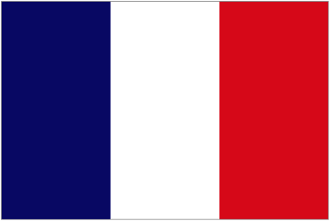

Are These Guys Racists?
Crowdsourced dictionary
Manually filtered a bit
/pol/ by far most hate speech use
/pol/ 12%
/sp/ 7.3%
/int/ 6.3%
Twitter 2.2%
or
?

Slide 36
Raids
Attempts to disrupt another site
Not a DDoS
Disrupts community that calls service home, not the service itself
Raids are a favorite past time on 4chan
“Pool’s closed!”
Have become less “funny” and more “scary” lately
It’s a socio-technical problem

Slide 37
Raids
Attempts to disrupt another site
Not a DDoS
Disrupts community that calls service home, not the service itself
Raids are a favorite past time on 4chan
“Pool’s closed!”
Have become less “funny” and more “scary” lately
It’s a socio-technical problem
This is something new…
Using technology to exploit fundamental aspects of human nature

Slide 38
Raids on YouTube Videos
YouTube is most commonly linked domain on /pol/
We anecdotally observed them being raided
Plural of anecdote is not data…
Can we find quantitative evidence of raids?!

Slide 39
How Might A Raid Happen?
Someone posts a YouTube link
Maybe with a prompt like “you know what to do”
Thread is an aggregation point for raiders
E.g., “Hah! I called that person a n**ger!”
If raid is taking place:
/pol/ thread and YT comments synchronized?

Slide 40
What Do We Mean By “Synchronization?”
Two time series
Second randomly shifted from first by 0.2 on avg

Slide 41
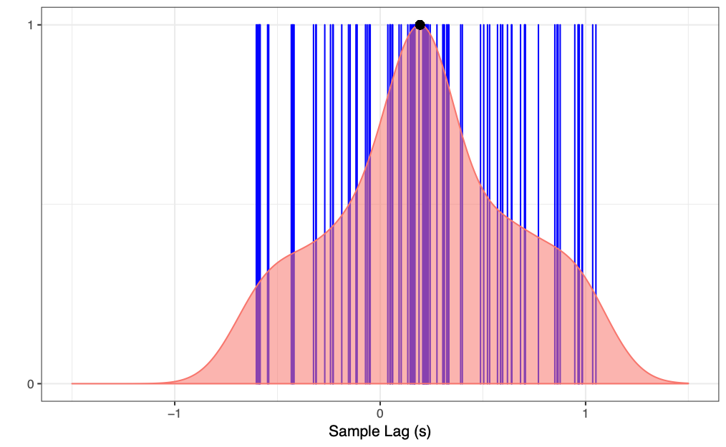
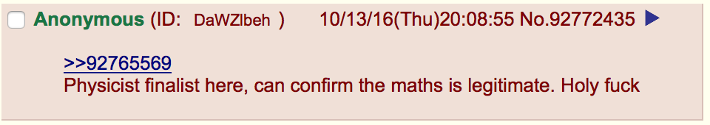
What Do We Mean By “Synchronization?”
Blue lines →
per-sample lag
Red area →
density of the lags
Peak of density curve = 0.2

Slide 42
How Can We Validate?
Just because there is synchronization, doesn’t mean a raid is going on
In fact, we expect some background noise
We need to come up with metric to validate
If a raid is happening, we would expect to see elevated levels of hate speech
→ more hate comments per second

Slide 43
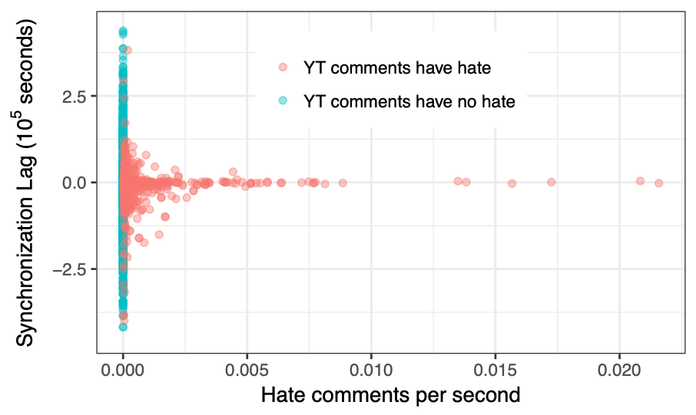
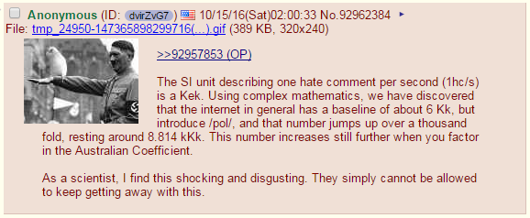
Evidence For Raids

Slide 44
Evidence For Raids
As lag approaches zero (i.e., more synchronization) we see more hate comments per second on YT

Slide 45
Evidence For Raids
Bottom line:
Fringe communities on the Web are not self contained
They effect other Web communities!

Slide 46
Summary
4chan is a notorious fringe Web community
While it has always been a not very nice place, it has gotten worse
Hate speech, disinformation, conspiracy theories, violence…
We have quantitative evidence they are affecting the rest of the Web
They are not the only extremist community on the Web

Slide 47
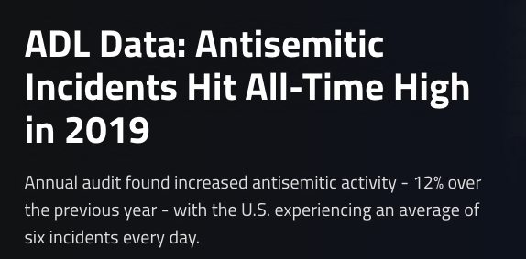
Antisemitism is on the rise
Notes:
Unfortunately, hate attacks against members of the jewish community are on the rise.
According to the Anti-Defamation league, an organization that aims to combat antisemtitism, in 2019 we hit an all-time high antisemitic activity, with a rise of over 12\% compared to 2018.

Slide 48
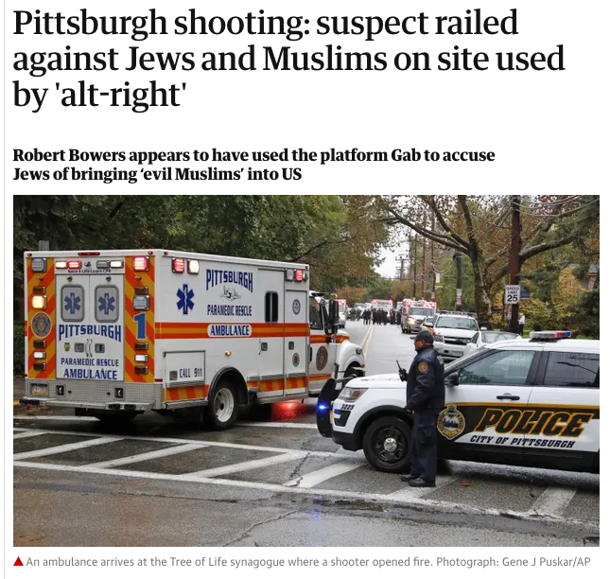
Antisemitism is incubated on social media platforms
Notes:
Antisemitism is not a real-world phenomenon only!
It exists in an online form and it is incubated on social networks and in particular on fringe Web communities.
For instance, the Pittsburg synagogue shooter was radicalized on Gab, before perpetrating the deadliest attack on the Jewish community.

Slide 49


Current efforts to understand and combat Antisemitism
There are numerous organizations who deal with antisemitism
They have a lot of “historical” knowledge and expertise
But, their methodology faces problems in the online world
It does not scale
It is slow
It does not deal well with emerging trends
Notes:
Despite these facts, antisemitism is not a new problem. There are numerous organizations that study this issue over the past decades.
Some examples include the Anti-Defamation league and the Southern Poverty Law center.
These organization has a lot of historical knowledge and are experts on the issue of antisemitism.
However, their approach is not ideal in the online world.
This is because they mainly rely on human analysts that qualitatively analyze the issue of antisemitism.
This approach faces many challenges on the online world since it does not scale, it is slow, and perhaps more importantly, it is hard to deal with emerging trends like the introduction of new coded language in a timely manner.

Slide 50


What can we really do about this?
Use scalable data-driven methods to detect, quantify, and understand
Antisemitic imagery (i.e., memes)
Collected data, between July 2016 and January 2018, from two fringe social media platforms
67M posts and 5.8M images
35M posts and 1.1M images
Notes:
The question here is what can we really do about this, as computer scientists?
In this work, we propose the use of data-driven quantitative methods to understand both Antisemitic language and antisemitic memes.
To this, we collect two large scale datasets from two fringe Web communities between July 2016 and January 2018.
Specifically, we collect 67M posts and 5.8M images from 4chan Politically Incorrect board and 35M posts and 1M images from Gab.

Slide 51
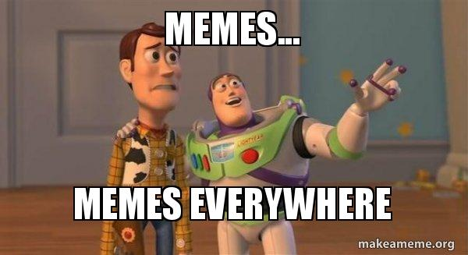

Slide 52
Memes are fun…

Slide 53
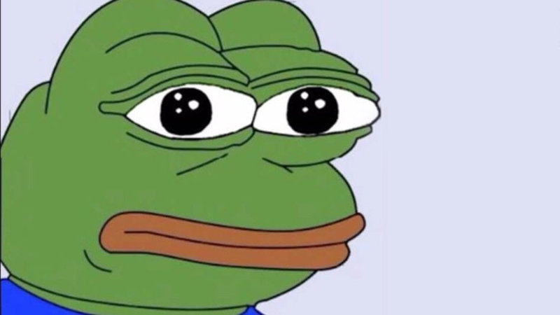
Not always though…

Slide 54

Not always though…

Slide 55
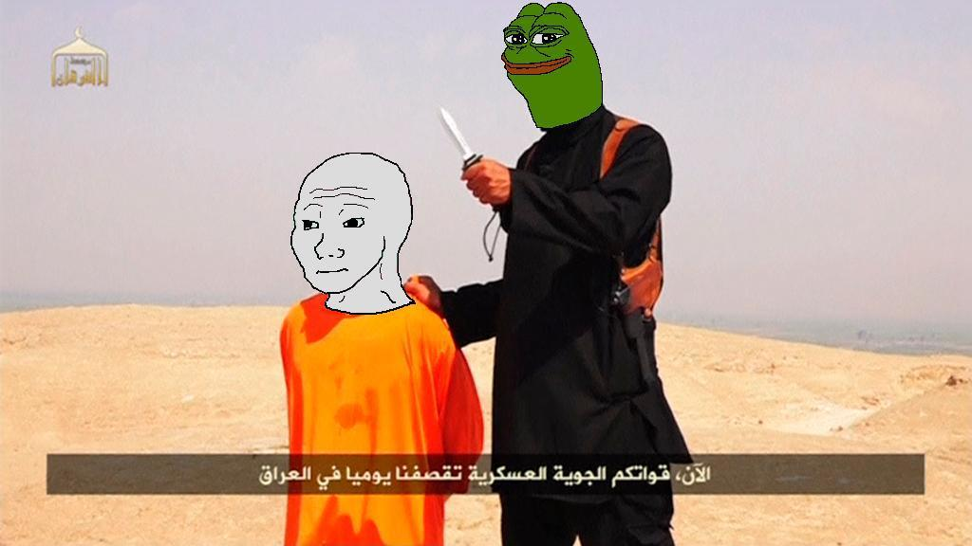
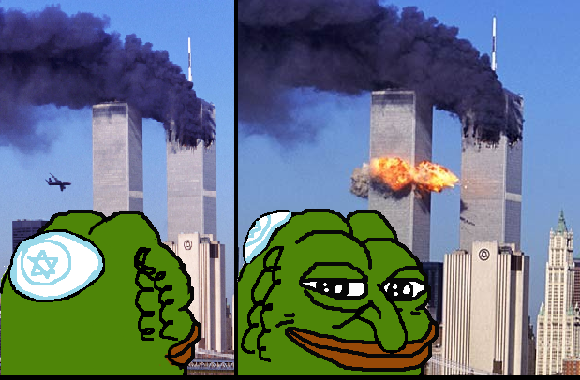
Not always though…

Slide 56
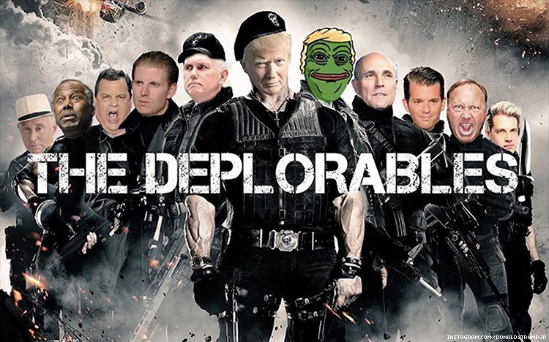
Memes in politics

Slide 57
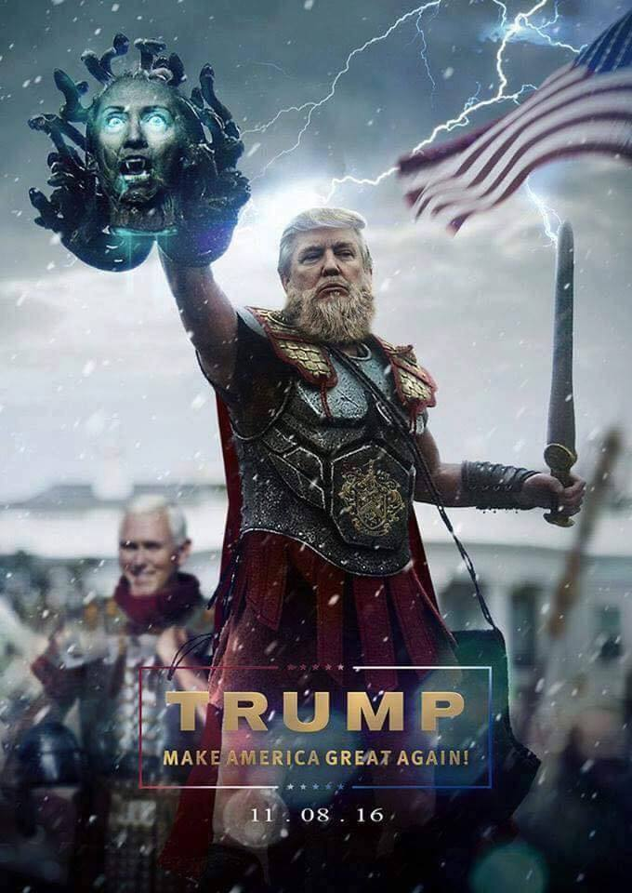
Memes in politics

Slide 58
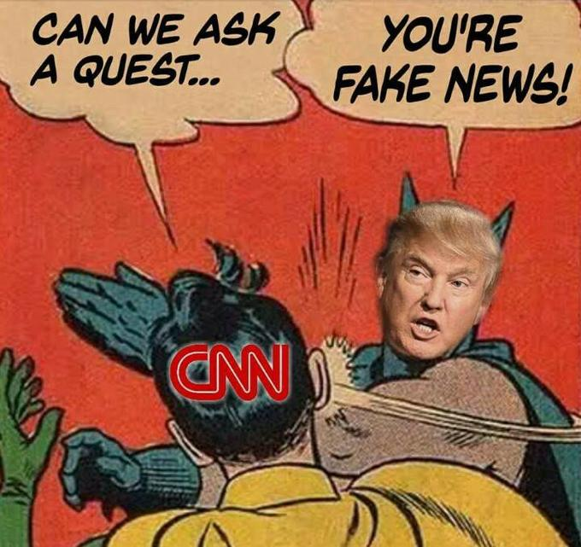
Memes in politics

Slide 59
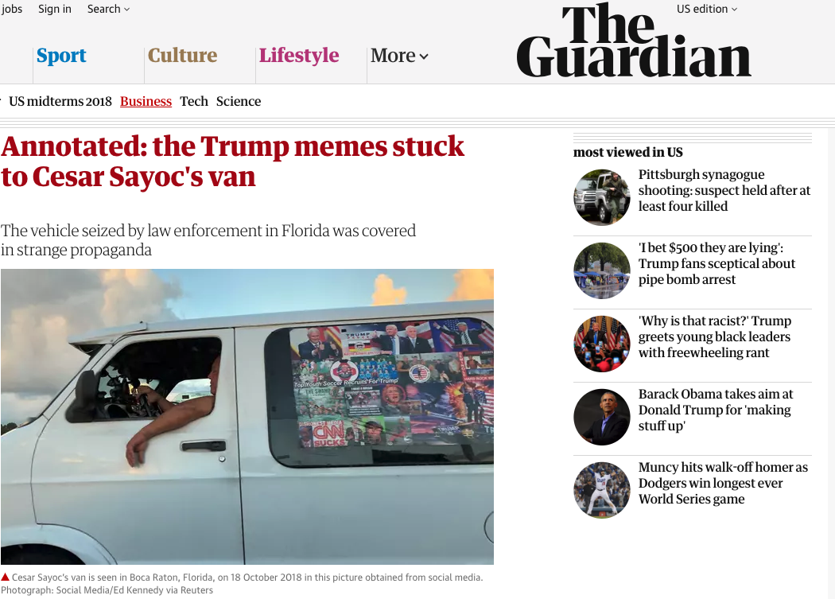
Memes in politics

Slide 60
Understanding Antisemitic imagery
Memes processing pipeline
Perceptual hashing
Clustering techniques
Ground truth data from Know Your Meme for annotation
Detect instances of the Happy Merchant meme
Notes:
Now, lets see our work on understanding Antisemitic imagery.
In this work, we re-use an image analysis pipeline presented at IMC 2018. The pipeline uses perceptual hashing and clustering technique to group together images according to their visual peculiarities. Then it uses ground truth data from Know Your Meme, an encyclopedia of memes, to annotate the clusters.
In this work, we focus on a specific meme called the Happy merchant meme. This meme shows a manipulative caricature of a jew and it is a highly offensive meme towards members of the jewish community.

Slide 61
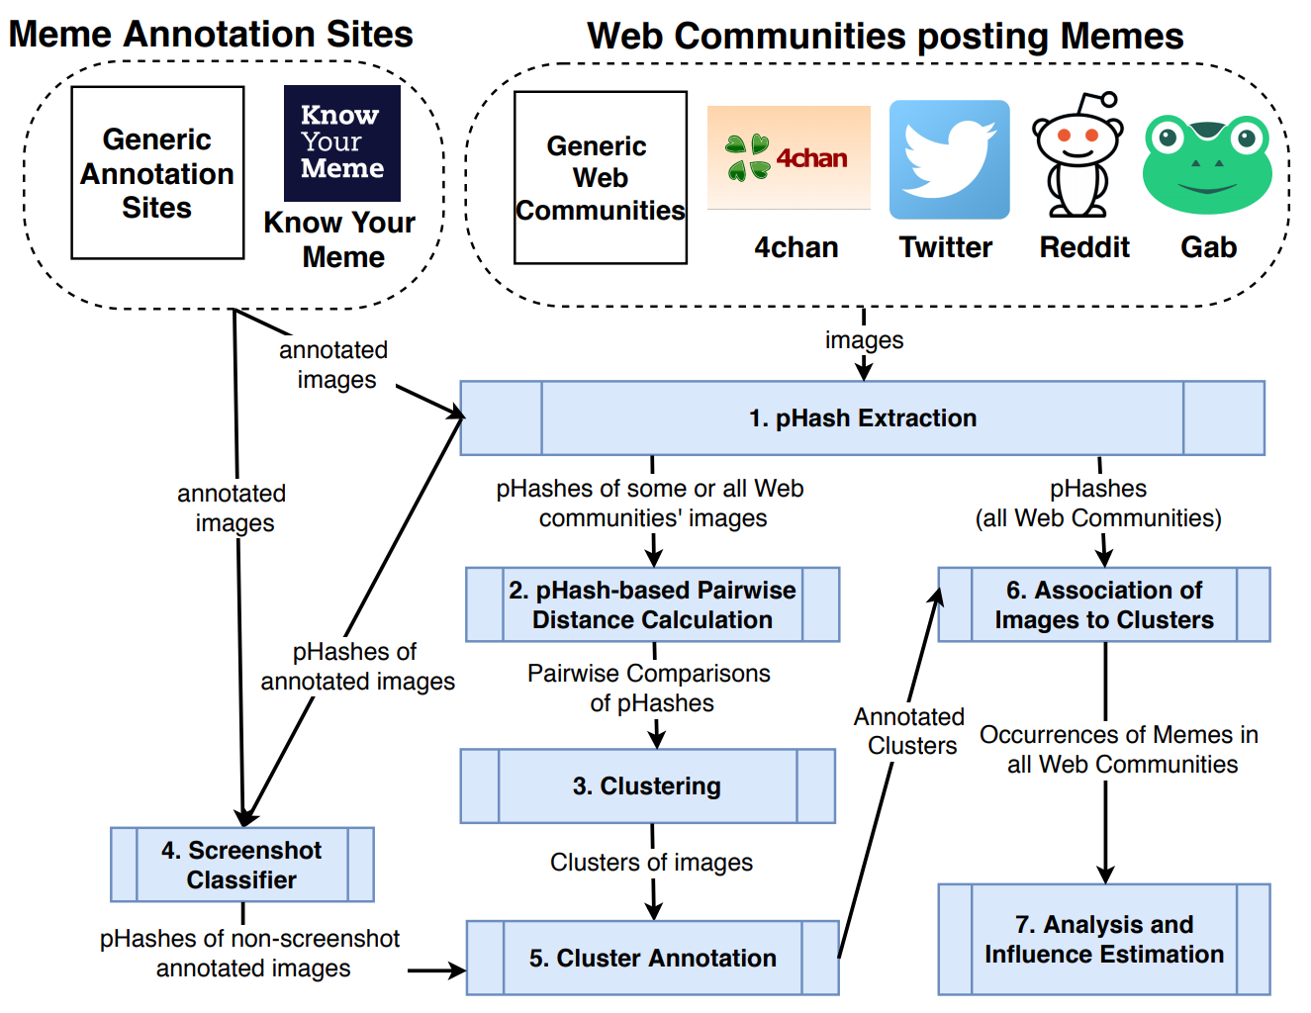
Memes processing pipeline
Notes:
The main idea of the pipeline is that we want to group visually similar images together, and each group will represent a variant of a meme. To achieve this, we use clustering techniques and an algorithm called perceptual hashing that captures how images look.

Slide 62
Notes:
Unfortunately, our analysis indicates that this antisemitic meme spilled to other more popular and mainstream memes like Pepe the Frog, Roll safe, and Feels good.
In this graph, each node is a cluster of images and by inspecting those clusters we were able to find instances of antisemitic memes on a large number of memes posted on 4chan and Gab.

Slide 63
Summary
Data-driven approaches to quantify and better understand
Antisemitic Imagery (i.e., memes)
These approaches are important because:
They can scale
They are fast
They can capture evolving and emerging trends
Notes:
To summarize in this work we have presented data driven approaches to study both antisemitic language and imagery, however, these approaches can also be used to study other types of hateful content.
These approaches are more well suited for this task compared to human analysts cause they scale, they are faster, and can capture evolving trends faster.
To conclude I like to highlight that there are more results in the paper for both language and images that I didn’t covered during this presentation, so if you are interested make sure to read the paper.

Slide 64

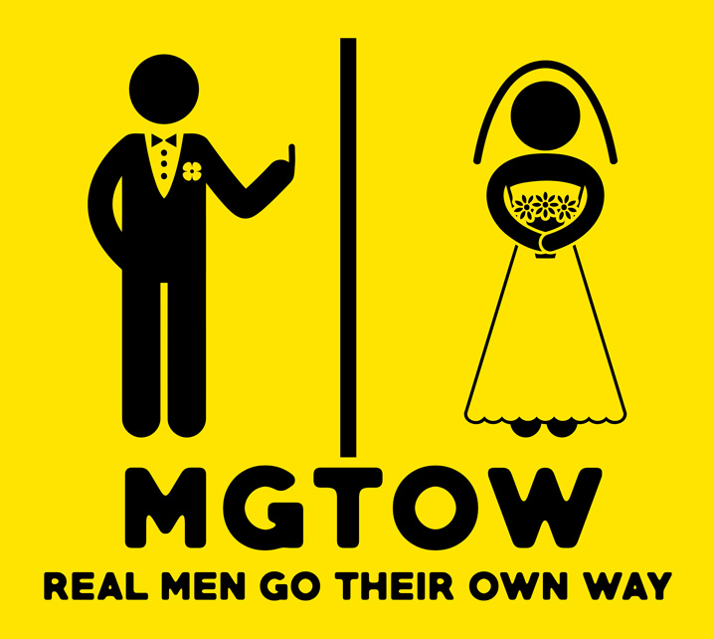
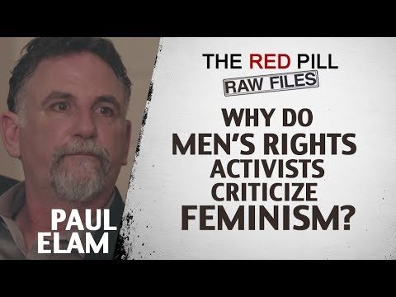

What is the Manosphere?
Notes:
So, if you made it to this poster you may be wondering: what is the manosphere?
In short, the manosphere is an umbrella term to designate several anti-feminist communities united by their belief in a crisis in masculinity.
Groups include
- Pick-up artists, a community built around “game,” i.e., techniques and strategies, that would allegedly help men pick up women.
- Men’s Rights Activists who avidly advocate against feminism and argue that society is rigged not against women, but against men.
- Men Going Their Own Way, or MGTOW, who also believe that society is rigged against men, but go an extra mile to advocate abstaining from relationships with women.
- And Incels, a group of young men united by strong feelings of rejection and rage towards the opposite sex.

Slide 65

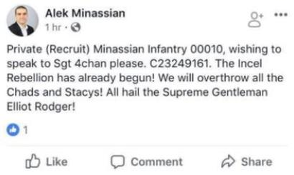
Why is it important to study it?
Notes:
We argue studying these communities is important because what happens in fringe communities often bleeds into the mainstream, be it in the form of memes, harassment, or real-world violence.
This image show the aftermath of an incel terrorist attack in Toronto, which killed 10 people in 2018.
Before the attack, the perpetrator posted on facebook that “The Incel Rebellion” had already began.

Slide 66
Data Used
52 subreddits
6 standalone forums
835k users
22M posts
Notes:
Studying the manosphere is difficult because it is spread throughout the web.
In our work we analyze 52 subreddits and 6 standalone forums which were broadly classified into different communities, most of which I already presented you.
In total, we have more than 22 million posts and 800k users.

Slide 67
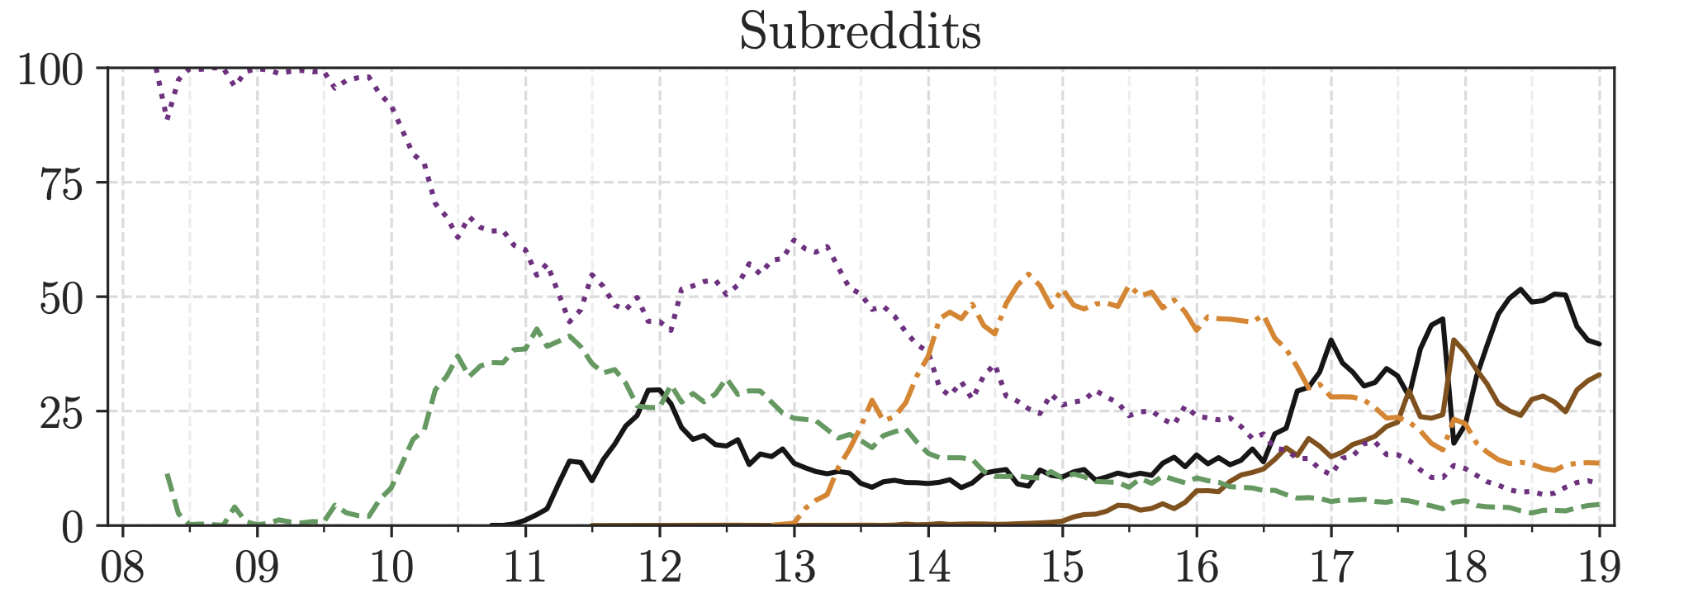
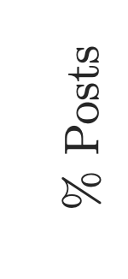
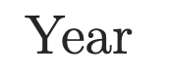
How has the popularity/levels of activity of the different Manosphere communities evolved over time?
RQ1
Men’s Rights Activists
Incels
Pick Up Artists
MGTOW
Notes:
So, the first thing we did was to analyze how have different communities evolved over the last decade.
The image shows the percentage of posts belonging to each of the communities across the years.
We find that older and communities such as men’s rights activists and pick-up artists are giving way to newer communities such as Incels and MGTOW.

Slide 68
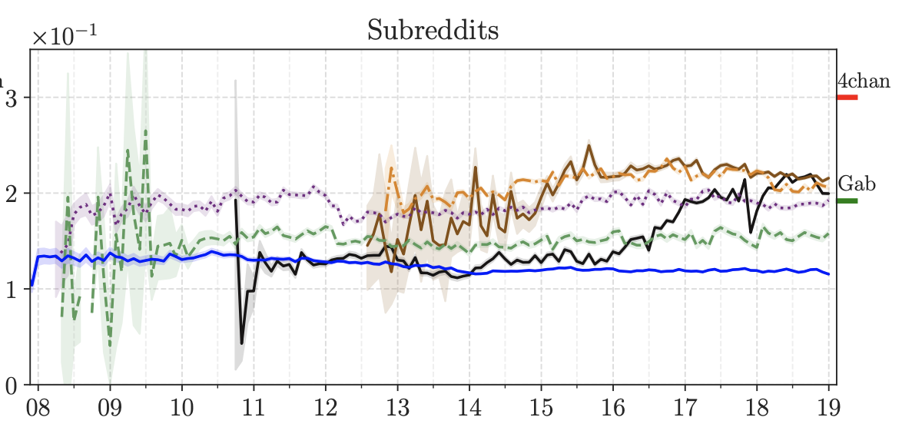
Has speech become more toxic and/or misogynistic over time?
RQ2
Incels
Men’s Rights Activists
MGTOW
Pick Up Artists
Baseline
Notes:
Lastly, we leveraged natural language to measure how toxic or mysoginistic the communities were through time.
Here we show the severe toxicity score from Google’s perspective API for the communities through the year.
We find that these newer communities that have gained traction in the last couple of years are significantly more toxic than the older ones.
Perhaps unsurprisingly, all communities are much more toxic than reddit in general

Slide 69
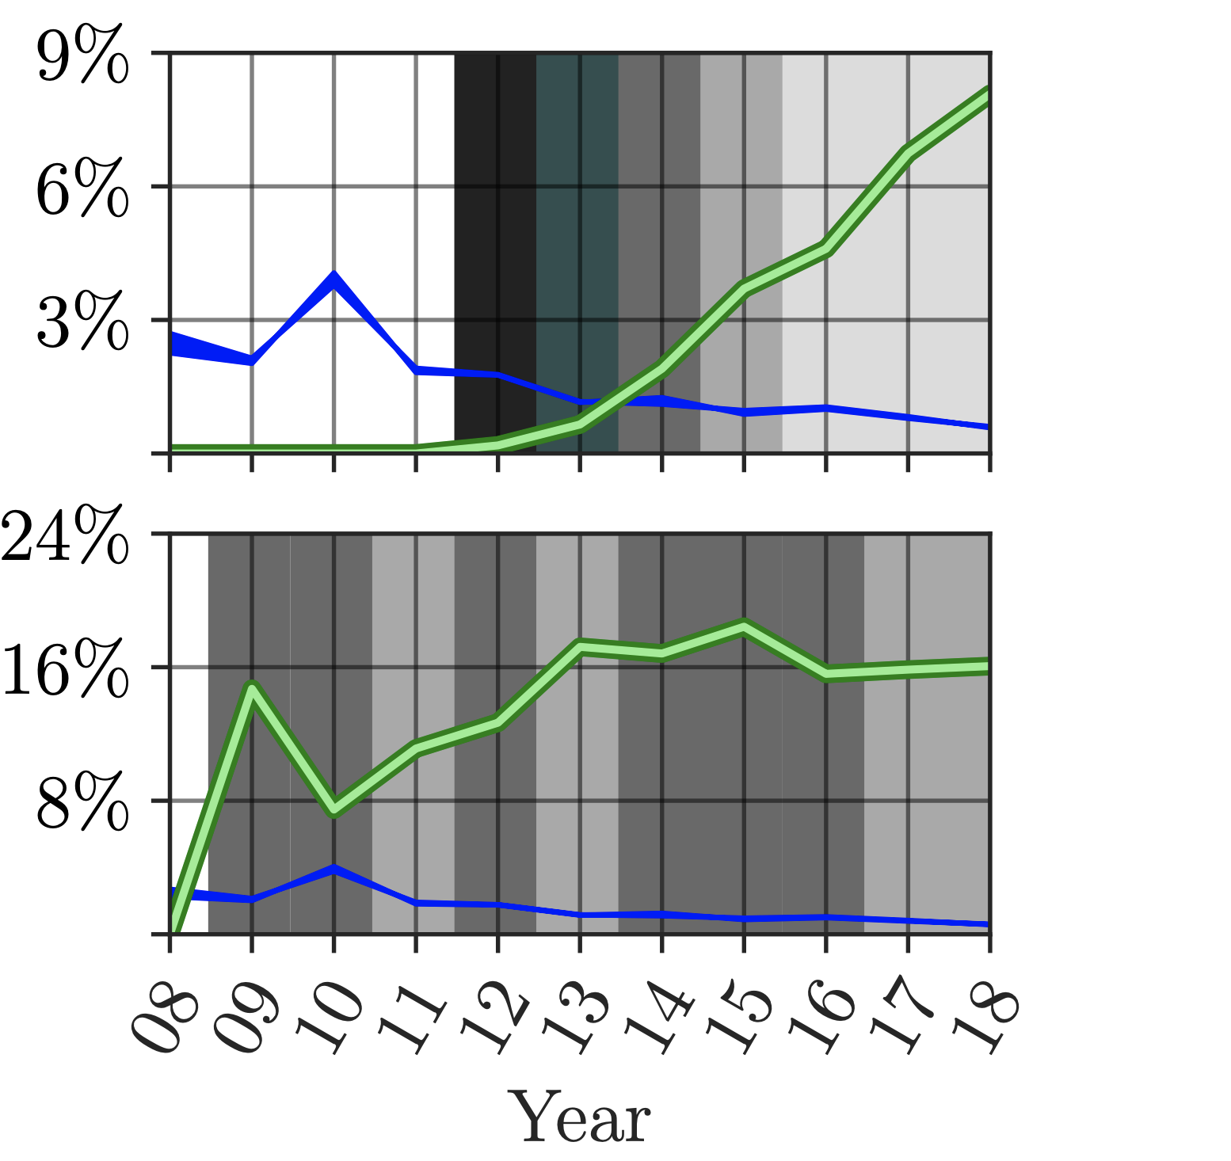
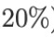
Has there been substantial migration of, or intersection in, users across communities?
RQ3
Overlap Coefficient
MRA → MGTOW
Jaccard Similarity
Baseline
Year
Notes:
Second, we analyze the intersection and migratory patterns between these communities.
There are a lot of interesting things about it, but I will only show one of them.
This plot shows the similarity between users in the men’s right activists community and the men going their own way community in reddit.
In green you can see the jaccard similarity.
In blue, a baseline for the jaccard similarity which is better explained in the paper.
Lastly, in the colors in the background, we show what percentage of users active in the MGTOW subreddits who were also active in the MRA subreddits in each year.
We find that the MGTOW community initially had over 75% overlap with MRA community. That is the initial members where mostly MRAs.
Also, the jaccard similarity between the communities is growing steadily!

Slide 70
Summary
Older communities, such as MRAs and PUAs are becoming less popular and active, while newer communities, like Incels and MGTOW, are thriving.
These communities do not exist in a vacuum! They are connected by members who migrate between them and who participate in multiple communities!
These communities are becoming increasingly more toxic!

Slide 71
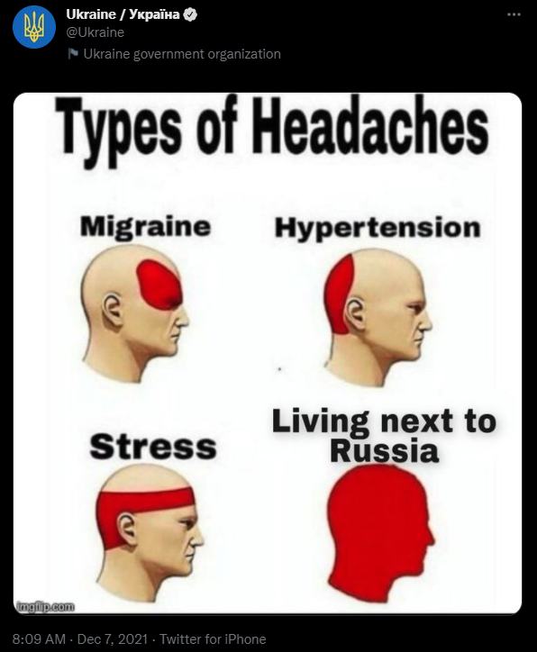
State-sponsored actors

Slide 72
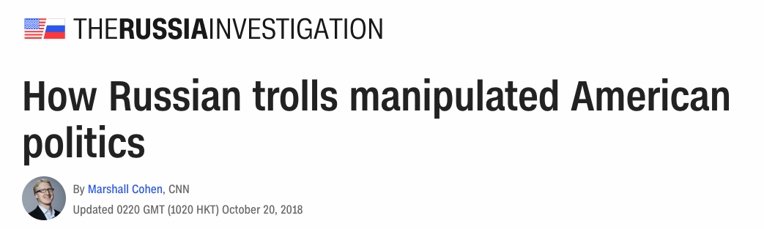
Notes:
Recently, anecdotal evidence emerged showing the involvement of Russian trolls on American politics.
By Russian trolls we mean individuals that are payed by the Russian governemtnet, that possess online accounts and are involved in online discussions with the goal to push an agenda.

Slide 73
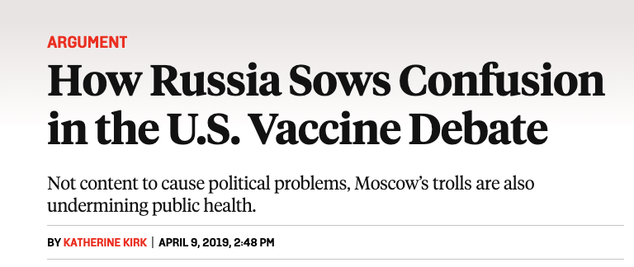
Notes:
These actos are not limited to politics. We have also seen evidence of involvement in other matters like the Vaccine debate, which can have a great societal impact.

Slide 74


Notes:
Motivated by this, social networks like Twitter and Reddit, started looking into detecting and banning such accounts. Indeed, they managed to detect and ban some accounts, and they also released some information for other researchers.
On October 17, 2018, Twitter released 10M tweets from Russian and Iranian trolls
On April 10, 2018, Reddit released a list of 944 Russian state-sponsored accounts

Slide 75
Datasets
Platform | Origin | # trolls | # trolls posts | # posts
Twitter | Russia | 3.83K | 3.66K | 9.04M
Twitter | Iran | 0.77K | 0.66K | 1.12M
Reddit | Russia | 0.94K | 0.33K | 21.32K
Notes:
Leverage ground truth information released by Twitter and Reddit
On October 17, 2018, Twitter released 10M tweets from Russian and Iranian trolls
On April 10, 2018, Reddit released a list of 944 Russian state-sponsored accounts

Slide 76
Questions
How does their behavior change over time?
What do they talk about?

Slide 77
Account Creation

Slide 78
Account Creation
80% of accounts created before 2016

Slide 79
Account Creation
57 accounts in July 2016
(RNC – Trump’s nomination )
80% of accounts created before 2016

Slide 80
Account Creation
57 accounts in July 2016
(RNC – Trump’s nomination )
190 accounts in July and August, 2017
(close to Charlottesville rally)
80% of accounts created before 2016

Slide 81
Account Creation
70% of the accounts created in a single burst in May 2015

Slide 82
Account Creation
No substantial bursts in account creation for Iranian trolls
70% of the accounts created in a single burst in May 2015

Slide 83
Unique accounts active over time

Slide 84
Unique accounts active over time
Large percentage of active account between May 2014 – end of 2015
(Ukrainian conflict)

Slide 85
Unique accounts active over time
A lot of accounts become inactive after the end of Ukrainian conflict
Large percentage of active account between May 2014 – end of 2015
(Ukrainian conflict)

Slide 86
Unique accounts active over time
Major increase coincide with the account creation burst
Notes:
For Russian trolls on Reddit --> (still small percentage. Others used for vote manipulation?)

Slide 87
Unique accounts active over time
Iranian trolls slowly building their troll army
Major increase coincide with the account creation burst
Notes:
For Russian trolls on Reddit --> (still small percentage. Others used for vote manipulation?)

Slide 88
Use of language – Russian trolls (Twitter)
A lot of Russian trolls
became inactive
Notes:
Deutsch likely related to the 2017 German Federal Elections

Slide 89
Use of language – Iranian trolls (Twitter)
France blocked deal
related to Iran’s nuclear program
Attack on Saudi Embassy In Tehran
(ended diplomatic relations between countries)
Notes:
French the predominant language during 2014 and 2015 (E.g., in November, 2013 France blocked a stopgap deal related to Iran’s uranium enrichment program [26], leading to some ery rhetoric from Iran’s government. )
English and Turkish are used throughout the course of our datasets
Started using Arabic language beginning of 2016. it coincides with an attack on the Saudi embassy in Tehran [22], the primary reason the two countries ended diplomatic relations.

Slide 90
Use of language – Iranian trolls (Twitter)
Overall, these findings highlight that their behavior is highly influenced by real-world events in conjunction with the ideology/agenda of their government.
France blocked deal
Related to Iran’s nuclear program
Attack on Saudi Embassy In Tehran
(ended diplomatic relations between countries)
Notes:
French the predominant language during 2014 and 2015 (E.g., in November, 2013 France blocked a stopgap deal related to Iran’s uranium enrichment program [26], leading to some ery rhetoric from Iran’s government. )
English and Turkish are used throughout the course of our datasets
Started using Arabic language beginning of 2016. it coincides with an attack on the Saudi embassy in Tehran [22], the primary reason the two countries ended diplomatic relations.

Slide 91
Content Analysis
Build two word2vec models on English tweets posted by Russian and Iranian trolls
Each model generates a multi-dimensional vector for each word
Allow us to assess whether words are used in similar contexts by providing cosine similarity between words

Slide 92
An example with the word “maga”
Russian trolls on Twitter |  | Iranian trolls on Twitter
Word | Cosine Similarity | Word | Cosine Similarity
trumparmi | 0.68 | impeachtrump | 0.81
trumptrain | 0.67 | stoptrump | 0.80
votetrump | 0.65 | fucktrump | 0.79
makeamericagreatagain | 0.65 | trumpisamoron | 0.79
draintheswamp | 0.62 | dumptrump | 0.79
trumppenc | 0.61 | ivankatrump | 0.77
wakeupamerica | 0.59 | theresist | 0.76
@realdonaldtrump | 0.58 | trumpresign | 0.76
thursdaythought | 0.57 | notmypresid | 0.76
realdonaldtrump | 0.57 | worstpresidentev | 0.75

Slide 93
Next, we look into hashtags…
News
Middle East
-related
Russian trolls on Twitter |  |  |  | Iranian trolls on Twitter
Hashtag | % | Hashtag | % | Hashtag | % | Hashtag | %
news | 9.5% | USA | 0.7% | Iran | 1.8% | Palestine | 0.6%
sports | 3.8% | breaking | 0.7% | Trump | 1.4% | Syria | 0.5%
politics | 3.0% | TopNews | 0.6% | Israel | 1.1% | Saudi | 0.5%
local | 2.1% | BlackLivesMatter | 0.6% | Yemen | 0.9% | EEUU | 0.5%
world | 1.1% | true | 0.5% | FreePalestine | 0.8% | Gaza | 0.5%
MAGA | 1.1% | Texas | 0.5% | QudsDay4Return | 0.8% | SaudiArabia | 0.4%
business | 1.0% | NewYork | 0.4% | US | 0.7% | Iuvm | 0.4%
Chicago | 0.9% | Fukushima2015 | 0.4% | realiran | 0.6% | InternationalQudsDay2018 | 0.4%
health | 0.8% | quote | 0.4% | ISIS | 0.6% | Realiran | 0.4%
love | 0.7% | Foke | 0.4% | DeleteIsrael | 0.6% | News | 0.4%
US politics
Social movements
MAGA
Fake News
Network
Anti-Israel

Slide 94
How can we better visualize the usage of hashtags while taking into account the context?
Build a graph from the word embeddings:
Each hashtag is a node
An edge exists between two nodes in the graph if their distance (as determined by their vector) is less than some pre-defined threshold

Slide 96
Size of node relative to the number of occurrences in dataset
Graph laid out in space according to distances (more similar words are closer together)
Run community detection → Color nodes according to their community

Slide 97
Iran-related
Israel-related
IUVM ☺
Pro-Palestine
Yemen
Anti-Trump

Slide 99
Hashtag community related to (local) News

Slide 100
Hashtag community related to politics and pro-Trump feelings

Slide 101
Hashtag Community related to BlackLivesMatter movement

Slide 102
Hashtag community with seemingly innocuous (general-purpose) hashtags

Slide 103
What URLs did they share?
Study the popularity of domains shared by Russian and Iranian trolls on Twitter and Reddit
Main findings:
On Twitter, Russian trolls shared a lot of Russian-speaking domains like riafan.ru, ria.ru, gazeta.ru, yandex.ru, etc.
On Reddit, we find imgur.com (likely an attempt to accumulate karma) and state-sponsored controlled domains like blackmattersus.com and donotshoot.us
For Iranian trolls, we find that most popular domain is awdnews.com (part of their IUVM network)

Slide 104

How to quantify influence?
Hawkes processes
Assume K processes
Each with a rate of events (i.e., posting of a URL), called the background rate
An event can cause impulse responses in other processes
Increases the rates of other processes for a period of time
Enables us to assess root cause of events

Slide 105
For our purposes
Extract the URLs posted by Russian/Iranian trolls, as well as all their appearances on:
Twitter (1% Streaming API), Reddit, 4chan’s /pol/, and Gab
Hawkes model with 6 processes
One for each platform/community of users (/pol/, Reddit, The_Donald subreddit, Twitter, Gab, Russian or Iranian trolls)
Distinct model for each URL; fit each model with Gibbs sampling

Slide 106
Influence Results –Russian trolls
1.29% of Twitter URLs (1%) are created because of URLs shared by Russian trolls
Russian trolls most influential on Gab (1.9%)

Slide 107
Influence Results – Iranian trolls
0.31% of Twitter URLs are created because of URLs shared by Iranian trolls
Iranian trolls most influential on The_Donald subreddit (1.52%)

Slide 108

Mitigation

Slide 109
Ok, lots of new understanding of what’s up…
Measurements and modeling of what is going on is important
But it is only the first step!
At some point, we need to make use of this new understanding
How can we mitigate these problems?
How do we assess the success of deployed mitigation strategies?

Slide 110


What Does A Raid Look Like?

Slide 111
What if we could predict a raid will happen?
We can definitely detect if a raid has happening
But the damage is already done at this point…
Can we maybe predict that a raid will happen?
There is some intuition that certain “types” of videos are likely to be raided
What if, at upload time, we could determine if a video will be raided?
It would be great if we could do this by only looking at the video itself!

Slide 112


Slide 113
Three Experiments
Experiment 1
Can we predict that a video has been linked to on 4chan in the first place?
Experiment 2
Can we discriminate between raided and non-raided videos?
Regardless if the video was linked to on 4chan or just randomly sampled
Experiment 3
Can we predict if a video linked to on 4chan will be raided?

Slide 114
Experiment 1 Can we predict that a video has been linked to on 4chan in the first place?
Notes:
Can we predict that a video has been linked to on 4chan in the first place?

Slide 115
Experiment 2 Can we discriminate between raided and non-raided videos?
Notes:
Can we discriminate between raided and non-raided videos?
Regardless if the video was linked to on 4chan or just randomly sampled

Slide 116
Experiment 3 Can we predict if a video linked to on 4chan will be raided?
Notes:
Can we predict if a video linked to on 4chan will be raided?

Slide 117

Detecting State Sponsored Troll accounts on social media

Slide 118


Slide 119


Slide 120


Slide 121
Great! We can actually predict something!
We can probably do something before a raid happens!
But what do we do?!
We could maybe temporarily disable comments
We could maybe put extra human moderators on it
We could …
How would we even measure the effectiveness of any of these?
We are not YouTube, we have limited access to data…

Slide 122
There is a deployed mitigation strategy

Slide 123

There is a deployed mitigation strategy

Slide 124

There is a deployed mitigation strategy

Slide 125
Deplatforming/Banning Communities
Social media platforms have made serious efforts here
The idea is that if some community is being toxic, excise it
Seems pretty straight forward
Some research shows it does actually clean up the platform a bit
But, turns out nothing is that simple…

Slide 126
Yup, they just make their own sites!

Slide 127

Yup, they just make their own sites!

Slide 128
Yup, they just make their own sites!
We know that fringe-communities like 4chan affect the rest of Web…
Just because Reddit is a bit cleaner, what happens when these communities move offsite?!?

Slide 129
We Look at Two Such Communities

Slide 130

We Look at Two Such Communities

Slide 131
We Look at Two Such Communities

Slide 132
Measure Across Several Axes
Activity levels
Were the communities dealt a serious blow?
Fixation dictionary
Previous work shows that fixation is a warning sign of radicalization
Group identification
Intensification of in-/out-group identification is also a warning sign
Toxicity level
A major justifications for banning is that these communities are toxic
I.e., they cause harm long lasting harm to the entire platform

Slide 133
Have the communities become less active?

Slide 134
Have the communities become less active?
New users are down…

Slide 135
Have the communities become less active?
For incels too…
New users are down…

Slide 136
Have the communities become less active?
Comments too for TD

Slide 137
Have the communities become less active?
Comments too for TD
Down, but increasing for incels…

Slide 138
Have the communities become less active?
Comments per user are up!!!!

Slide 139
Have the communities become less active?
Comments per user are up!!!!
Comments per user are up!!!!

Slide 140
Have the communities become less active?
Ok, so there was some blow made…
But, the users left are definitely more active than the average user pre-ban…
Comments per user are up!!!!
Comments per user are up!!!!

Slide 141
Ok, about these users that stayed…
It’s great that Reddit did disrupt the community
There is definitely reduced activity
Fewer users overall
Less new users
But, have the users that migrated changed?

Slide 142
Changes in individual users

Slide 143
Changes in individual users
We matched reddit user names to new platform user names

Slide 144
Changes in individual users
No statistically significant change in toxicity…
They are still as toxic as ever

Slide 145
Changes in individual users
Statistically significant increase in negative emotions

Slide 146
Changes in individual users
Also for hostility…
Statistically significant increase in negative emotions

Slide 147
Changes in individual users
Large-scale banning/deplatforming of communities might backfire to some extent.
It is relatively easy to create new platforms, and the portion of community that migrates has increases in some signals for radicalization
Also for hostility…
Statistically significant increase in negative emotions

Slide 148
Summary
We have entered a new historical age
There are a host of emerging problems
We’ve only just begun to identify and understand these
State-sponsored actors are in the game
There are tons of challenges to understanding things
There’s only so much content any person can look at
Mitigation techniques are in their infancy
We are just learning how to automatically detect this behavior
It’s a socio-technical problem; solutions can have unforeseen consequences

